Slide 1
Hotel Management System
Using Core Java and Swing...

Slide 2

ABOUT US
NIKHIL SINGH
FROM BENGAL COLLEGE OF ENGINEERING AND TECHNOLOGY
Guided By Prof. Chandan Mukherjee

Slide 3
Contents
20XX
Abstract
Project Objective
System Requirements
Project Scope
Functional Requirements
Application Flow Diagram
Future Scope
Benefits of our project
20XX
20XX
What We Learnt ?
Conclusion

Slide 4

Abstract
The project “Hotel Management System” is developed in java, which mainly focuses on operations like Booking Room, checking the available rooms, allocating room to the customer, Adding Room, etc. It features a familiar and well thought-out, an attractive user interface.
The Backend of the project is supported by File System.

Slide 5
Project Objective
To develop a interactive Hotel management System using Java and Swing which :-
Maintain an effective and efficient system of room booking.
Operate a record management system for user to view available rooms.
Maintain a record of guest who are logging in and also of those who are booking the room.
The admin has the power to add, delete, Search and clear the status of the rooms in the hotel.
The records of the added rooms with their availability are stored in the records of the admin.

Slide 6

System Requirements
Hardware Specs:-
CPU - Dual core 64-bit 2.8 GHz 8.00 GT/s CPUs
Ram- 2 GB (minimum) or more.
Free Disk Space- 2 GB or more.
Software Specs :-
Operating system- Any OS because Java is Platform independent.
Runtime Environment - JRE 1.7 or more
Applications- Eclipse IDE and Java development Toolkit.

Slide 7
Project Scope
Scope of the project involves Users and Admin
1
2
3
User has to signup first only then he is allowed to search and book room. After Sign up user has to login with his account and then he is prompted to search the room. If the room of his choice is available then a table with the available room is displayed
User can now book the required room with his respective check in and checkout date and book the room. After booking the bill is display on the screen
Admin has more power and control over the software. He can add the rooms of his desire. After adding a new room its status is by default false means available and after the checkout the status becomes true.

Slide 8




Functional Requirements
Modules Of The Program
User Module
User can search the room of his choice if available he/she can book that room if not available then he/she has to search another room for booking.
Admin Module
Admin can add the rooms, display the available room, delete the rooms , view the guest login as well as the guest booking details and also can the search the booking details of the user from the available record details here user id.
Signup Module
Signup module is the frame of the Home. Here from one window user can create his account to perform all the respective operation of room booking.

Slide 9
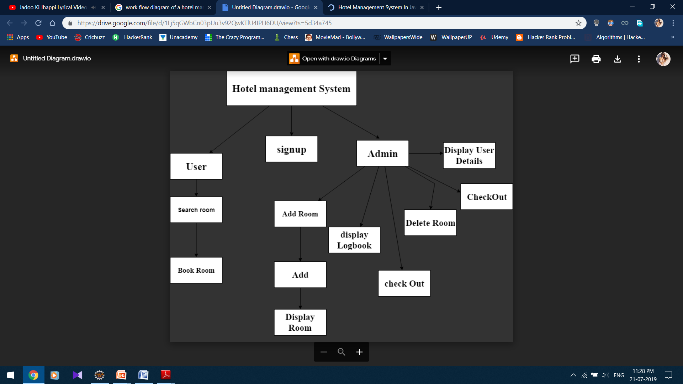
Application Flow Diagram

Slide 10
Future Scope Of Improvement
3
2
Allocation of rooms based on expected vacancies is also difficult as it requires extra work.
1
The proposed Online Hotel Management System is much more efficient in terms of human and monetary resources.
Database will be much more efficient and faster than the one developed and easier to maintain.

Slide 11
Benefits of our project
GUI
Attractive GUI for user interaction. User will feel more freedom to access our software.
Effective file management
File System is used in our project to ensure easy record management for the admin.
Validation to ensure error free System
Validation of the code is done to ensure error free records.

Slide 12
What We Learnt ?
Polymorphism Inheritance Encapsulation
Abstraction Classes Objects
Methods Message Passing Dynamic Initialization
Concepts of OOP
Designing
GUI
Used to create window-based applications. It is built on the top of AWT API and entirely written in java.
Unlike AWT, Java Swing provides platform-independent and lightweight components.

Slide 13

CONCLUSION
Hotel Management System
The hotel management system also helps in maintaining the overall activities that take place in the hotel to run smoothly.
Through this hotel management system application even people or the customers can enjoy a very good way of service that they would get.
It will also help the customers to enjoy a smart way of service that they would get from the particular hotel.

Slide 14

THANK YOU!
Nikhil Singh
Email:
nikhil.4598@gmail.com

